Slide 1





Bioenergy Potential Prediction from Crop Residue
By:- Dnyaneshwari Pawar

Slide 2

Learning Objectives
Understand how crop residue can be used to generate bioenergy and why its prediction is important.
Identify key agricultural parameters (yield, RPR, moisture, calorific value) affecting bioenergy potential.
Preprocess and prepare real-world agricultural datasets for machine learning.
Apply and train a Linear regression model for predicting bioenergy potential.
Evaluate model performance using metrics such as R², MAE, and RMSE.
Visualize model accuracy through Actual vs Predicted comparison plots.
Save and deploy the trained model for real-world prediction and decision support.
GOAL
Source :
www.freepik.com/

Slide 3
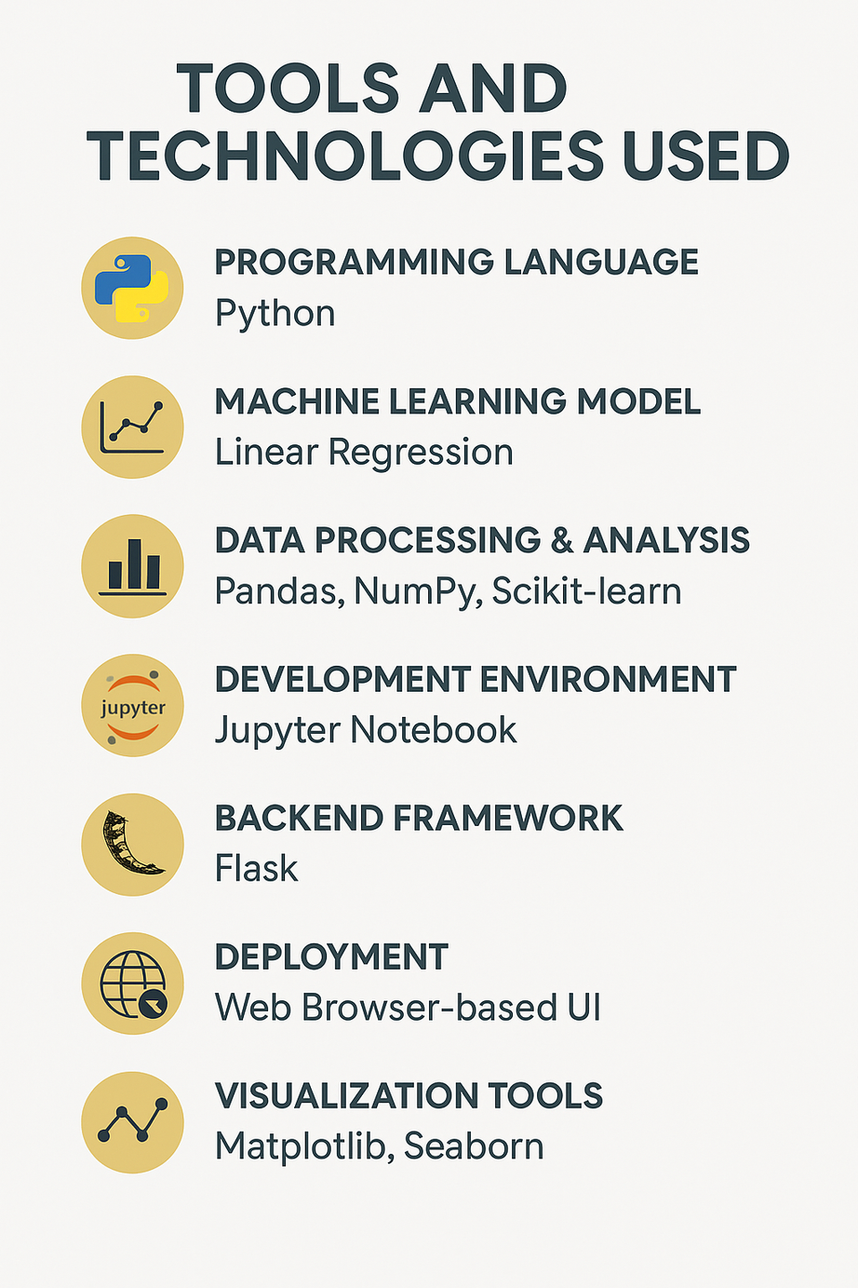
Tools and Technology used
Programming Language
Python – Used for data processing, model building, and backend development.
Machine Learning Model
Linear Regression Model – Used to predict bioenergy potential based on crop residue parameters.
Data Processing & Analysis
Pandas – Data cleaning and feature engineering
NumPy – Numerical computation
Scikit-learn – Model training, evaluation, and prediction
Development Environment
Jupyter Notebook – Used for experimentation, model training, and visualization
Backend Framework
Flask – Used to build a lightweight web interface for user input and prediction

Slide 4
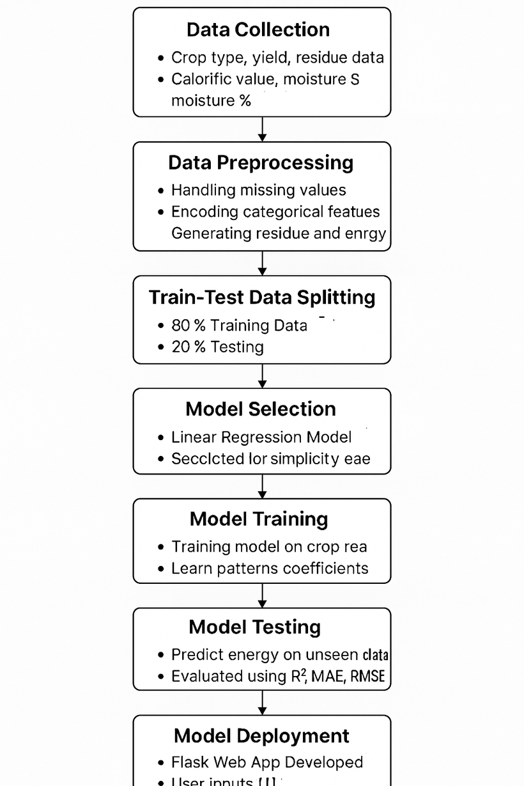
Methodology
Data Collection: Gathered crop residue dataset with yield, RPR, moisture, calorific value, and energy output.
Data Preprocessing: Cleaned dataset, handled missing values, encoded Crop Type, engineered new features.
Feature Selection: Selected key inputs affecting energy potential (Yield, RPR, Moisture %, CV, etc.).
Train–Test Split: Divided dataset into 80% training and 20% testing for unbiased validation.
Model Training & Evaluation: Trained Linear Regression model and achieved 96.38% accuracy (R² = 0.9638).
Deployment: Built Flask web app and deployed prediction system on browser for user access.

Slide 5
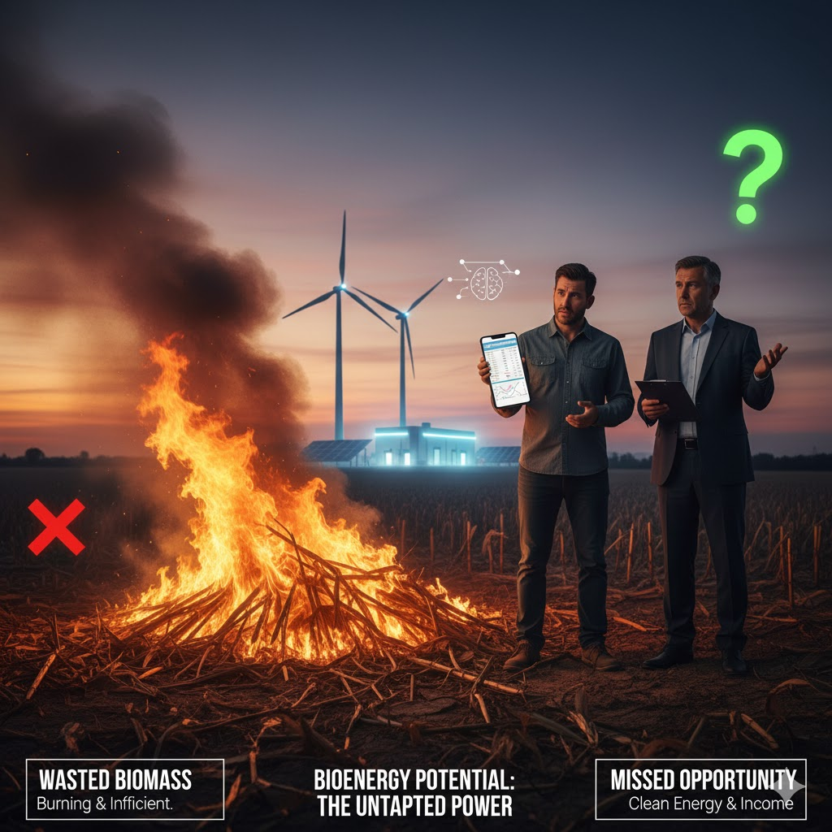
Problem Statement:
Agricultural crop residues hold significant bioenergy potential, yet most of this biomass is burned or wasted due to the absence of simple and reliable estimation methods. Existing calculations require technical parameters such as residue-to-product ratio, moisture content, and calorific value, making them difficult for farmers and policymakers to use. Therefore, there is a need for a data-driven system that can accurately predict bioenergy potential from basic crop inputs, enabling effective utilization of crop residues for renewable energy production.

Slide 6

Proposed Solution:
Build a Machine Learning-based prediction model to estimate bioenergy potential from crop residue.
Use key agricultural parameters such as crop type, yield, moisture %, RPR, and calorific value as model inputs.
Train a regression model (Linear Regression) using real residue-energy dataset for accurate output prediction.
Evaluate prediction accuracy using performance metrics (R², MAE, RMSE) and validation plots.
Develop a Flask-based web interface where users enter crop details and get instant predicted energy output.
Display results in MJ and equivalent kWh, making energy estimation understandable and usable.
Deploy the model in a browser-accessible application, enabling farmers, researchers, and planners to use it easily.

Slide 7
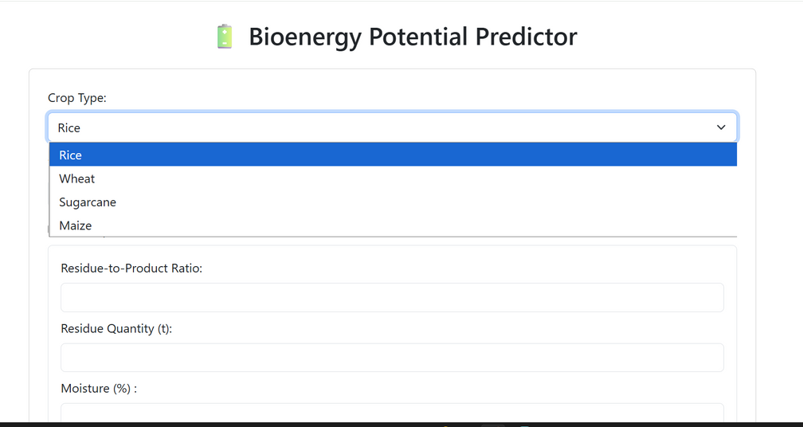
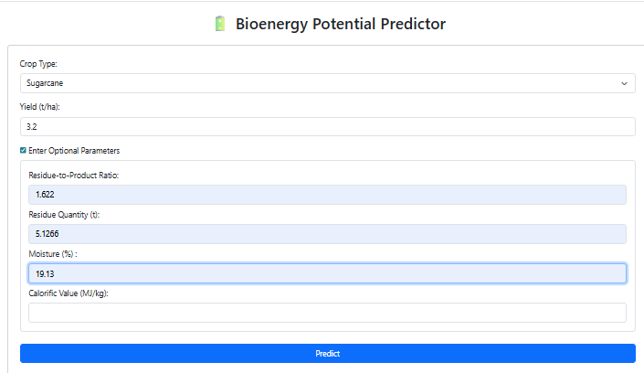
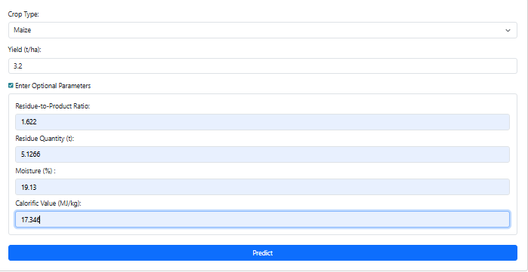
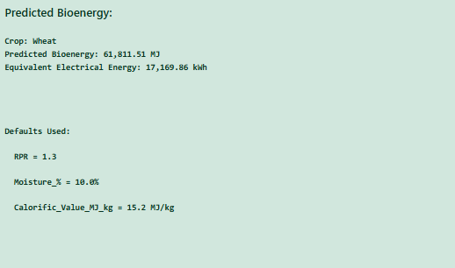
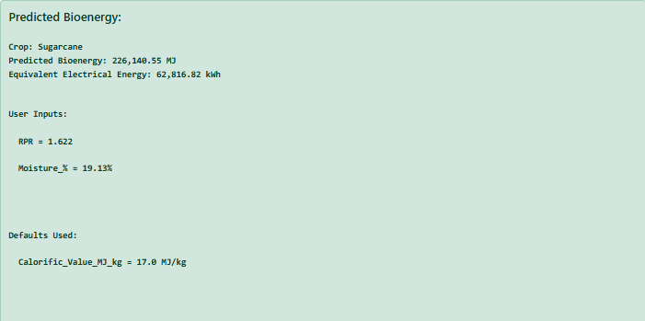
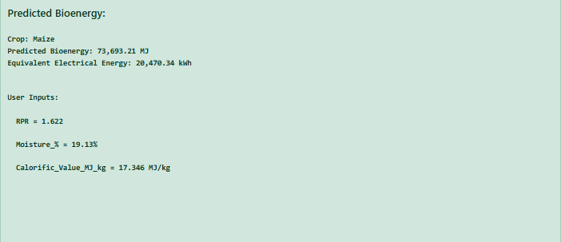
Screenshot of Output:

Slide 8
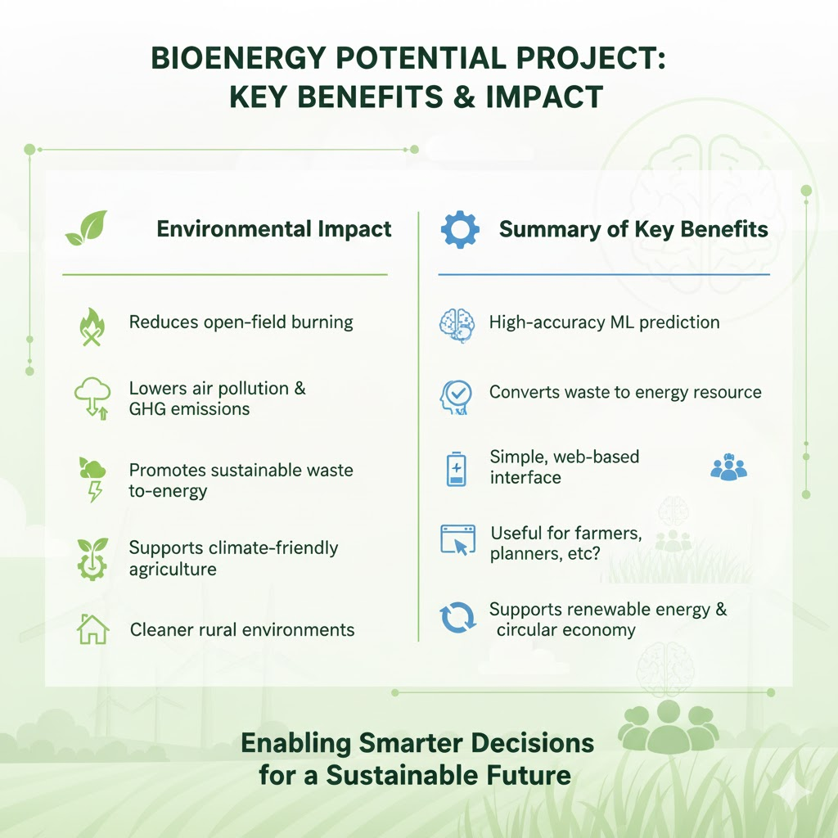
Conclusion:
The developed machine learning model accurately predicts the bioenergy potential of agricultural crop residues, offering a reliable and practical decision-support tool. By converting residue parameters into usable energy estimates, the system promotes sustainable biomass utilization and reduces dependency on conventional fossil fuels. The strong agreement between predicted and actual values confirms the model’s effectiveness and suitability for real-world deployment. Overall, this work supports cleaner agricultural practices, encourages renewable energy adoption, and assists farmers, researchers, and policymakers in making informed decisions regarding residue management and energy generation.

